Slide 1
Electricity Budget Calculator
Calculates KWh, Bill, and Days
Student’s Name: Tonia A. Kiazolu
ID: 9759
Course Name: Object Oriented Programming with Python & Java
Date: November 9, 2026

Slide 2
Problem Statement
Many LEC prepaid users in Liberia buy electricity units without knowing how many kWh they will actually get
Users do not know how long their units will last before they run out
It is confusing to convert between USD and LRD because the exchange rate changes
Service fee and tariff rate are deducted, but most users don't know how to calculate the final units
Without a tool, users overspend, run out of power unexpectedly, and cannot plan or budget their electricity Therefore, there is a need for a simple tool that estimates electricity units and how many days they will last.

Slide 3
Project Objectives
The main goals of this project are to:
1. Calculate how many kWh a user will get from their money
2. Convert currency between USD and LRD using the exchange rate
3. Estimate how many days the electricity units will last
4. Estimate the bill / cost for a desired amount of kWh
5. Calculate appliance consumption using watt-to-kWh conversion
6. Make it simple and easy for any LEC prepaid user to use

Slide 4
System Inputs
The user will enter the following inputs:
1. Budget Amount: The amount of money the user wants to spend
2. Currency Type: USD or LRD
3. Exchange Rate: Current rate for converting USD to LRD
4. Tariff Rate: Cost per kWh (e.g. 32 LRD per kWh)
5. Service Fee: Fixed fee deducted by LEC (e.g. 150 LRD)
6. Appliance Usage: List of appliances, their watts, and hours used per day.
These inputs are used to calculate the units and how long they will last.

Slide 5
System Process
How the system works:
1. User Input- User enters budget, currency, exchange rate, tariff, service fee, and appliance usage
2. Currency Conversion- If currency is USD, convert to LRD: USD × Exchange Rate. If LRD, use amount as it is
3. Net Amount Calculation - Subtract service fee: Net Amount = Amount - Service Fee
4. Unit Calculation - Divide net amount by tariff: kWh = Net Amount ÷ Tariff Rate
5. Duration Estimate - Calculate daily kWh from appliances, then: Days = Total kWh ÷ Daily kWh
6. Display Result - Show user the kWh they will get, the bill, and how many days it will last.

Slide 6
Calculation Formulas
Currency Conversion:
LRD Amount = USD Amount × Exchange Rate
2. Net Amount After Fee:
Net Amount = Total Amount (LRD) - Service Fee
3. Units / kWh Calculation:
kWh = Net Amount ÷ Tariff Rate
4. Appliance Daily Consumption:
Daily kWh = (Watts × Hours Used Per Day) ÷ 1000
5. Duration / Days It Will Last:
Days = Total kWh ÷ Total Daily kWh

Slide 7
Appliance Consumption Logic
Appliances are measured in Watts (W)
- 1000 Watts = 1 Kilowatt (kW)
To find how much electricity an appliance uses per day:
Daily kWh = (Watts × Hours Used Per Day) ÷ 1000
Example: A 100W bulb used for 5 hours: (100 × 5) ÷ 1000 = 0.5 kWh per day
The system adds the daily kWh of all appliances together to get the Total Daily Consumption
This total is then used to estimate how many days the purchased units will last.

Slide 8
Sample Calculation
Given Inputs:
Budget Amount: $10 USD
Exchange Rate: 200 LRD = $1
Tariff Rate: 32 LRD per kWh
Service Fee: 150 LRD
Appliances: 1 Bulb (100W, 5 hrs), 1 Fan (75W, 8 hrs), 1 TV (120W, 4 hrs)
1 Convert to LRD: 10 × 200 = 2,000 LRD
2. Net Amount: 2,000 - 150 = 1,850 LRD
3. kWh: 1,850 ÷ 32 = 57.81 kWh
4. Appliance Consumption:
- Bulb: (100 × 5) ÷ 1000 = 0.50 kWh
- Fan: (75 × 8) ÷ 1000 = 0.60 kWh
- TV: (120 × 4) ÷ 1000 = 0.48 kWh
- Total Daily = 1.58 kWh
5. Duration: 57.81 ÷ 1.58 = 36.59 Days
Result: $10 gives 57.81 kWh and lasts about 37 days..

Slide 9
Program Design
Pseudocode / Logic Flow:
1. START
2. Ask user for Budget Amount
3. Ask user for Currency Type (USD or LRD)
4. Ask user for Exchange Rate
5. Ask user for Tariff Rate
6. Ask user for Service Fee
7. IF Currency = USD THEN Amount in LRD = USD × Exchange Rate ELSE Amount in LRD = Budget Amount
8. Net Amount = Amount in LRD - Service
9. kWh = Net Amount ÷ Tariff Rate
10. Ask user for Appliances (Watts and Hours per day
11. For each appliance: Daily kWh = (Watts × Hours) ÷ 1000
12. Total Daily kWh = Sum of all Daily kWh
13. Days = kWh ÷ Total Daily
14 DISPLAY kWh, Net Amount, and Days
15. END
Flowchart: Start → Input → Conversion → Net Amount → kWh → Appliance Calculation → Duration → Display Result → End

Slide 10
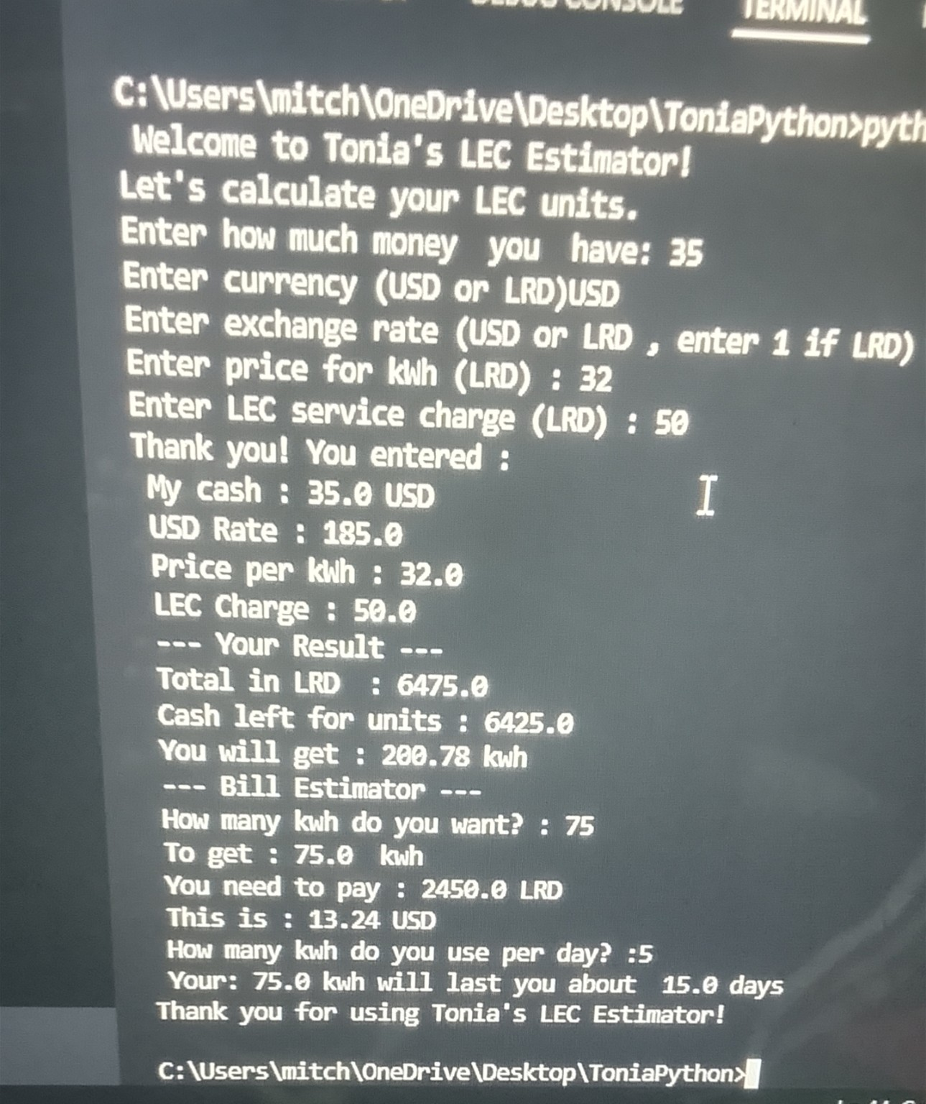
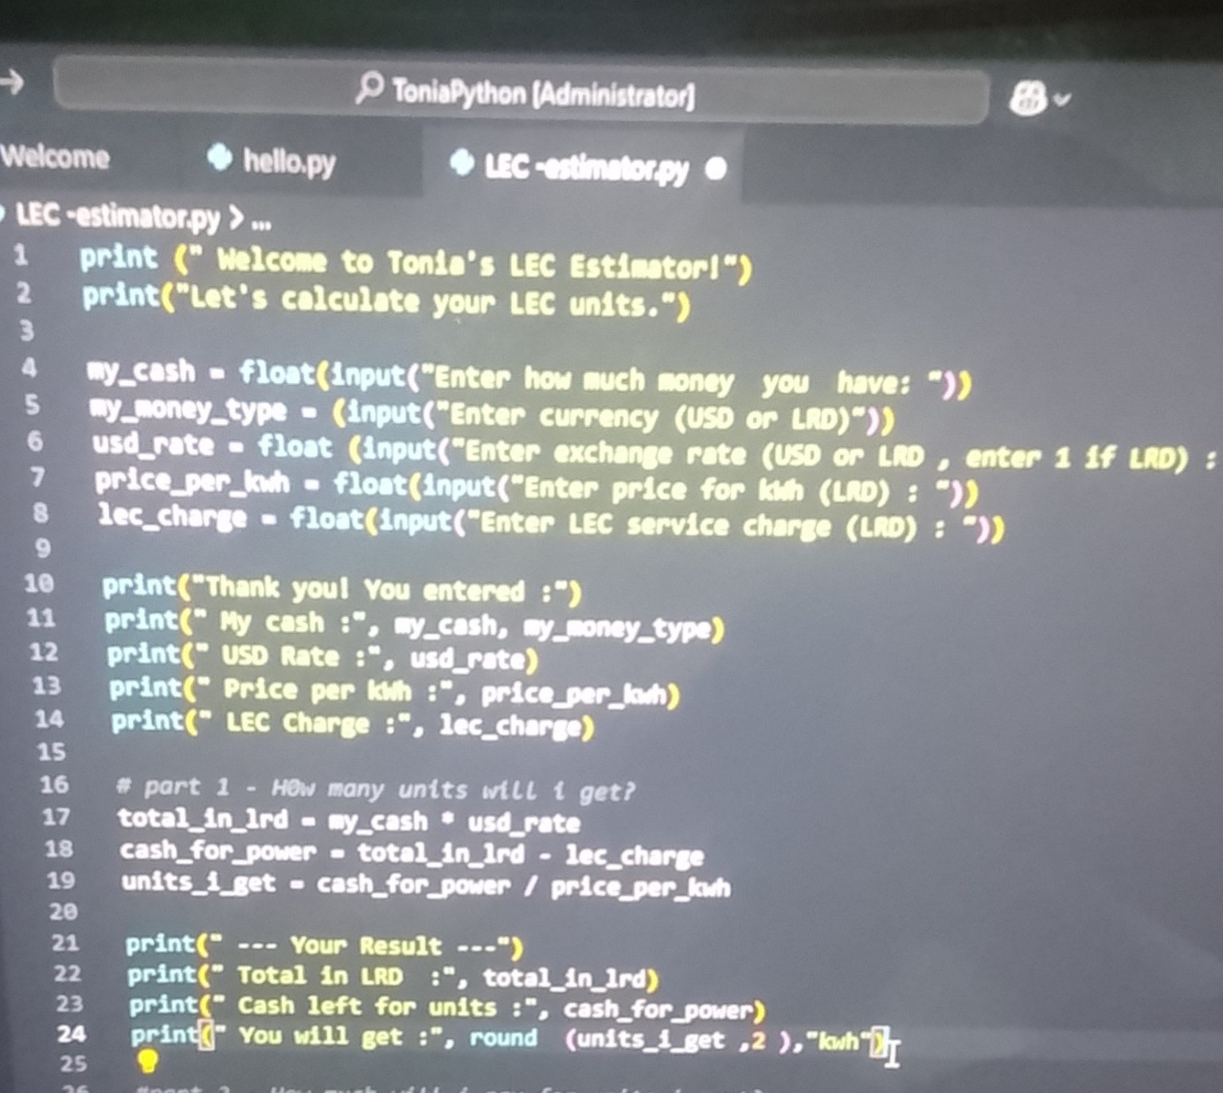
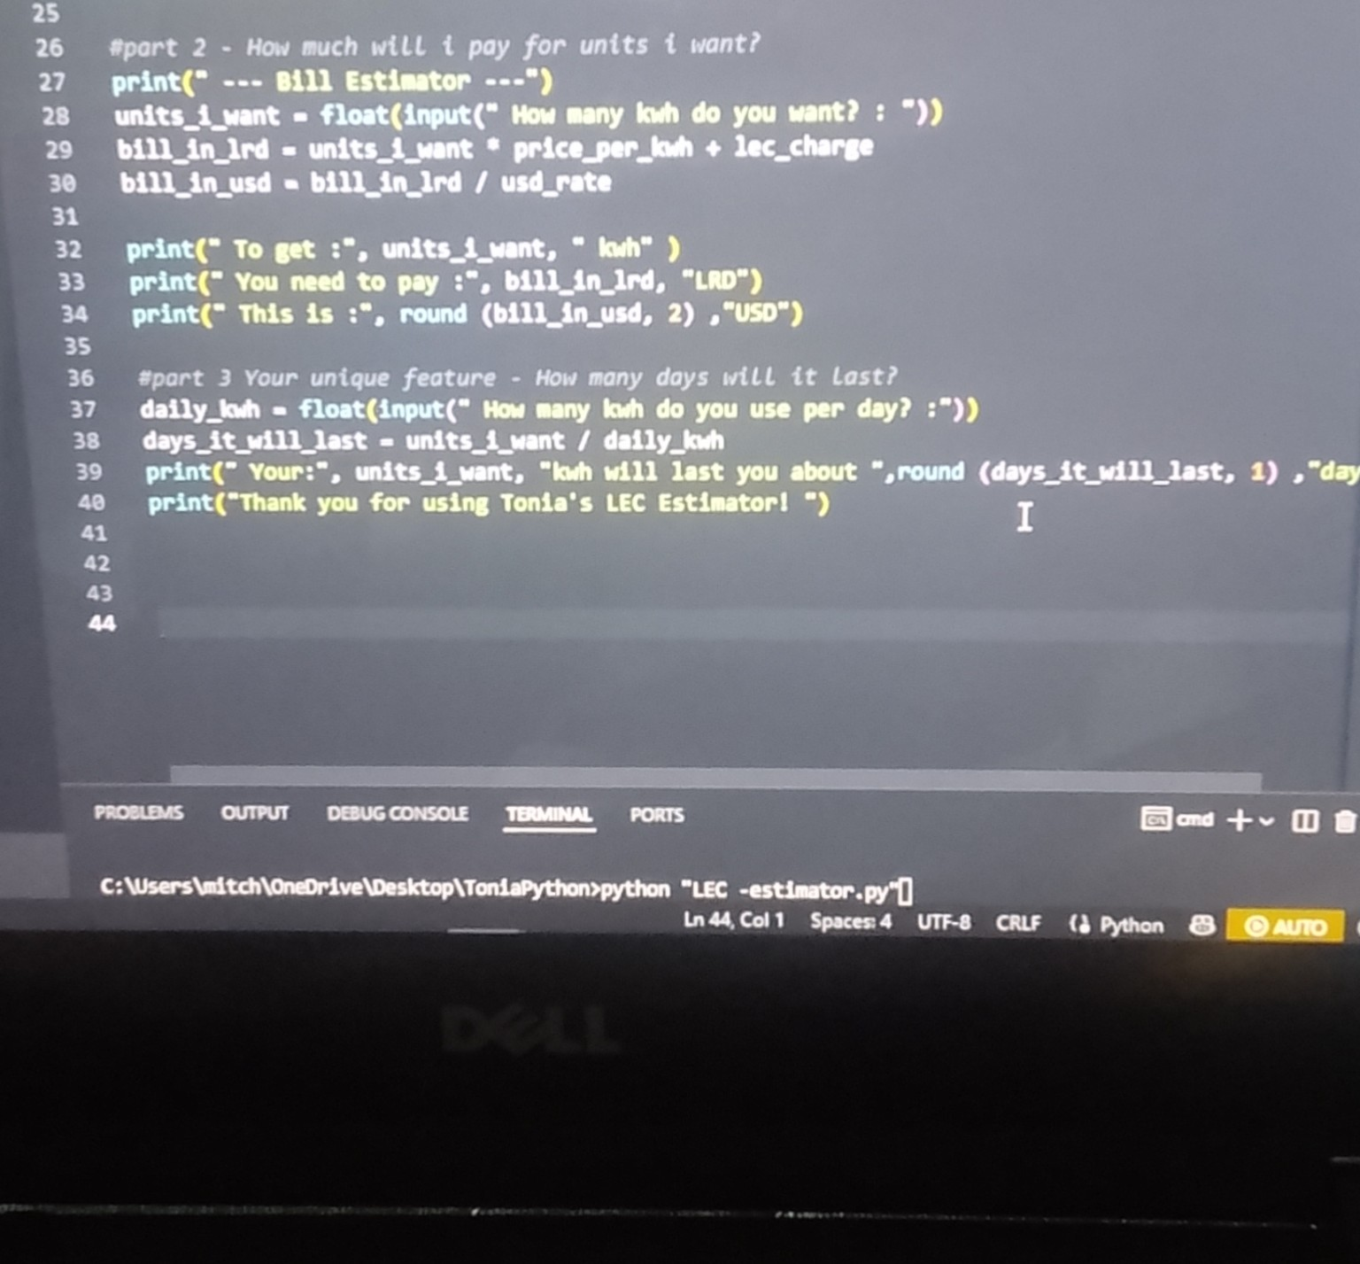
Screenshots / Demo

Slide 11
Challenges & Lessons Learned
Challenges Faced:
Getting the currency conversion correct - USD to LRD
Remembering to subtract the LEC service charge before calculating kWh
Handling user input errors - e.g. typing letters instead of numbers
Understanding how kWh and daily usage relate to days
Lessons Learned:
Learned how to use input(), float(), and print() in Python
Learned how to use if / else for currency choice
Learned how to break a real-life problem into small steps
Learned that planning (pseudocode) makes coding easier
What I Would Improve:
Add error checking so the program does not crash on wrong input
Add a list of common appliances with their watts already saved
Make the program ask for appliances one by one automatically

Slide 12
Conclusion & Recommendations
The LEC Estimator successfully helps users know how many units (kWh) their money can buy
It also helps users know how much money they need for a certain number of units
And it estimates how many days their units will last based on daily usage
The project shows how Python can solve a real-life problem in Liberia
It helps families plan, budget, and avoid wasting electricity
Thank You!

